Slide 1


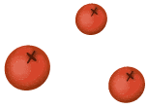




TinyTask
Presentation 2
SOFTWARE ENGINEERING-CTW XLS Group ACS66 Fall Semester 2023
Cristal Cervantes, Kyle Laxamana, Joseph Paxton, Sagar Patel, Alexis Cruz Aboytes
Notes:
Do not spend more than 15 seconds on this

Slide 2

01
Wireframes

Slide 3
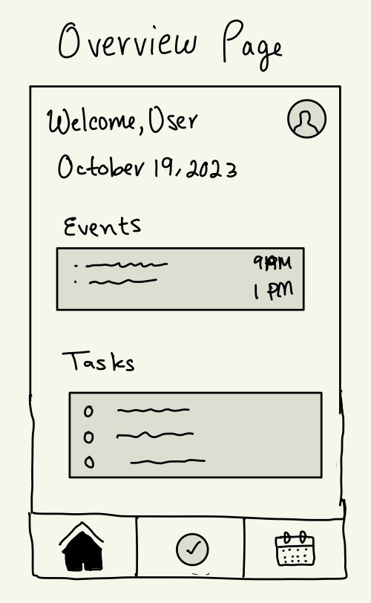

Overview Page
Welcoming Interface: The wireframe starts with a "Welcome, user" message and displays the current date.
Profile Icon: this clickable icon leads to user profiles and settings.
Events Section: Shows upcoming events along with their scheduled times, giving users a quick preview of what's coming up.
Tasks Section: Displays tasks and checkboxes on the left for easy task management and completion.
Navigation Bar:
Home Icon: Returns users to the Overview page.
Checkmark Button: Navigates to the Tasks page.
Calendar Button: Takes users to the Calendar view.
Key Features:
User-Friendly Design: Information is accessible and interactions are smooth.
Convenient Access: The UI provides quick and easy access to important sections.
Task Management: Enables users to interact with tasks using the checkboxes.
Notes:
Spend no more than 50 seconds on this

Slide 4
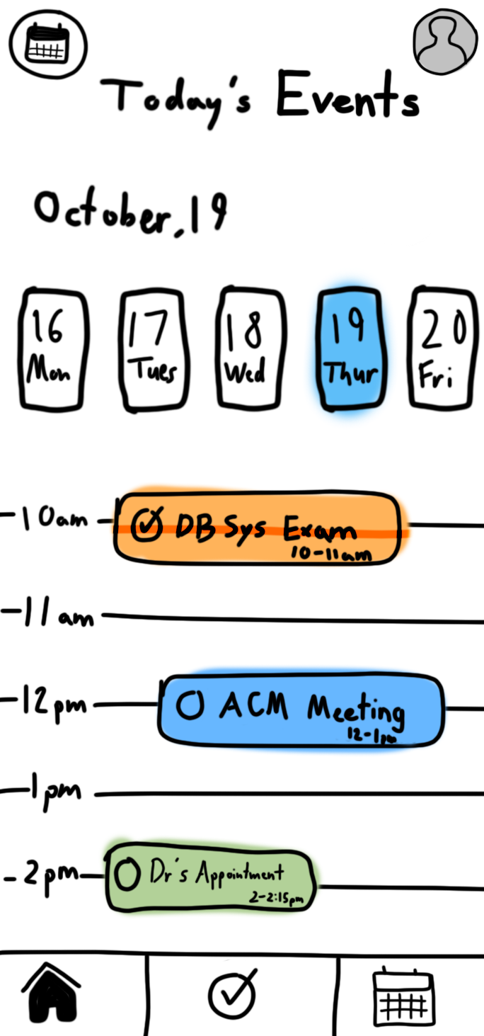
Event Timeblock View
The TimeBlock View is a versatile tool that empowers users to take control of their time, improve time management, and boost productivity by providing a clear and intuitive visual representation of their daily schedule.
It encourages better planning, organization, and execution of tasks and appointments, ultimately helping users make the most of their valuable time.
Overlay of Activities: Tasks and events from the user’s calendar are integrated into the Timeblock view , providing a comprehensive overview of the day.
Color Coding: Time blocks are color-coded to categorize different types of tasks and events.
Notes:
Spend no more than 50 seconds on this

Slide 5
02
Testing Scenarios

Slide 6
Test Scenarios
User Story
Test Scenarios
The user opens up Tiny Tasks to add three events:
A database exam from 10:00 am to 11:00 am
an ACM meeting from 12:00pm to 1:00pm
and a Doctor’s appointment from 2:00pm to 3:15pm.
Verify that user can successfully add an event to the timeblock calendar
Verify that when the user comes back that the event is still on the calendar.
Verify that the user cannot create duplicate or overlapping events at the same time.
Verify that the user gets a notification when the close to the event
Notes:
Spend no more than 45 seconds on this

Slide 7
Test Scenarios
User Story
Test Scenarios
The user opens up Tiny Tasks to add three tasks. They have to pick up their medicine at the pharmacy, hit the treadmill for one hour and clean their cat’s litter box. Two hours later the user has accomplished one of their tasks of the day so they mark it off.
Verify that the user can access the task section from the overview page
Verify that the user can add the task effortlessly with all the required details
Verify that that the task is accurately saved and displayed in the task list
Verify that user can edit or delete the task as needed
Verify that the user can check off the task once completed
Notes:
Spend no more than 45 seconds on this

Slide 8
03
Progress Report

Slide 9
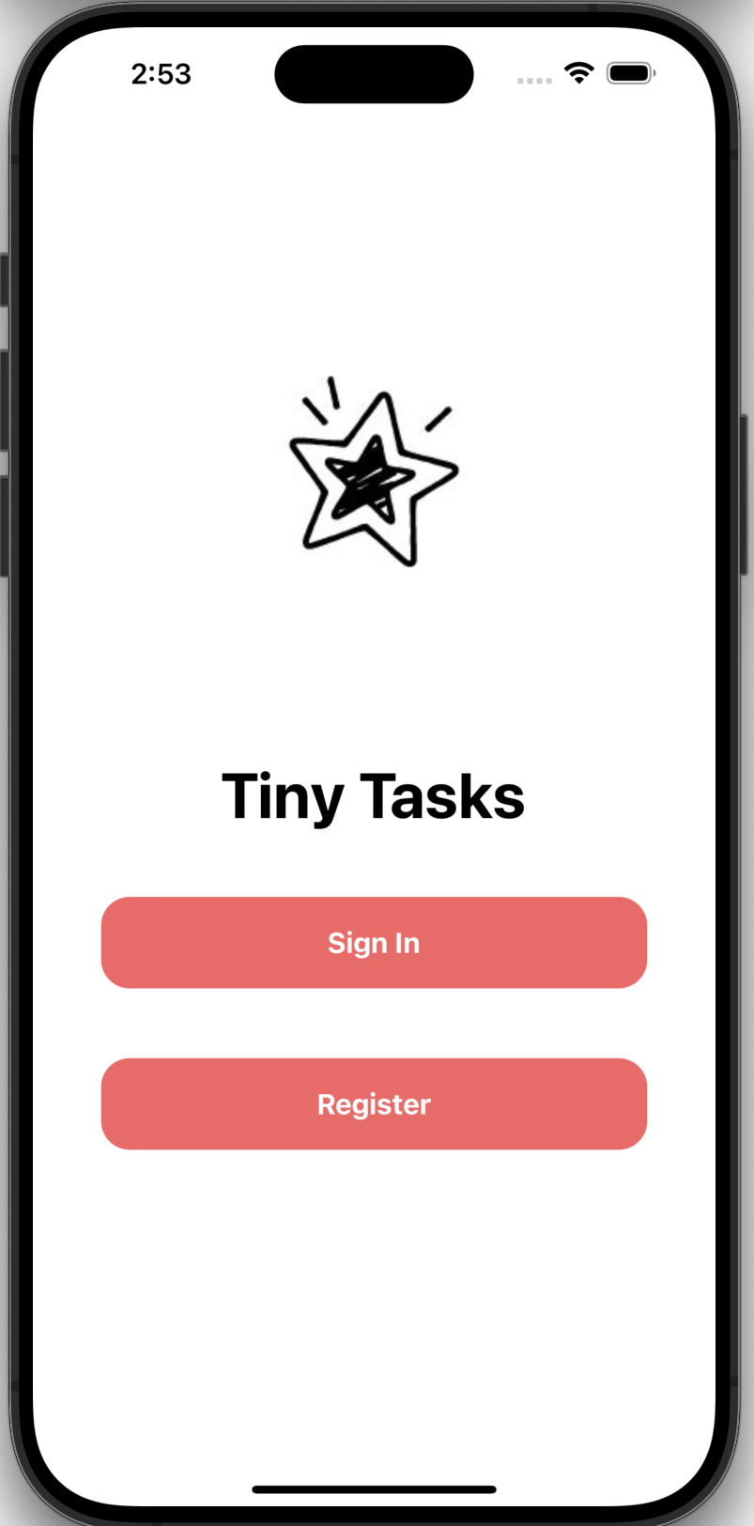
Login Page
Cris has been working on setting up the UI for the login page and researching how to use MongoDB Realm with it.
Notes:
20 seconds

Slide 10
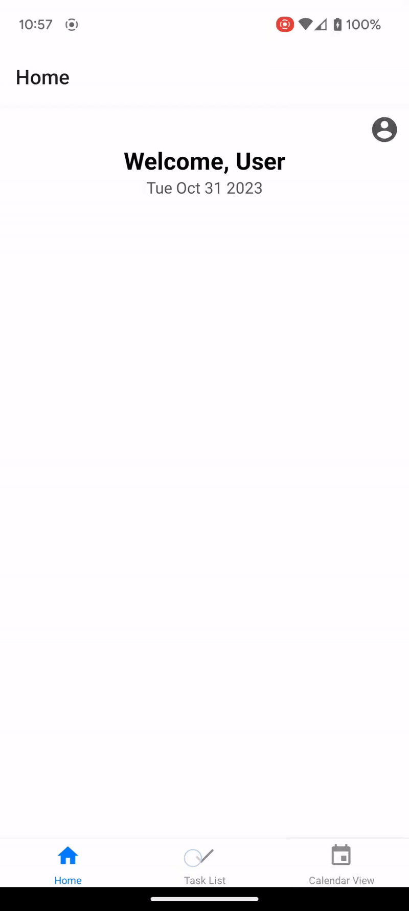
Navigation Bar
Sagar has set up a React Project on the GitHub that has a navigation bar and different pages for each of the screens we will be building out.
Notes:
20 seconds

Slide 11
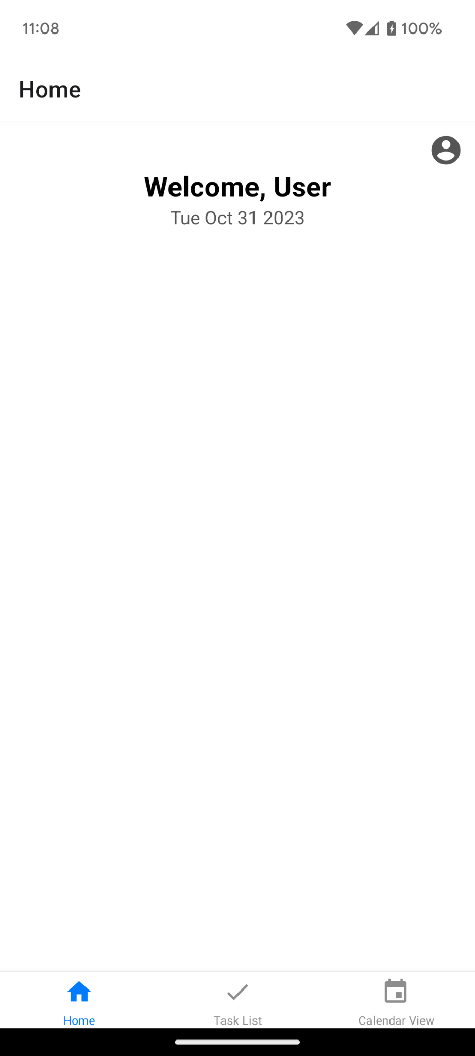
Overview Page
Sagar has made the overview page AKA the home page which has an Account/Settings button and welcomes the user with the current date.
Notes:
20 seconds

Slide 12
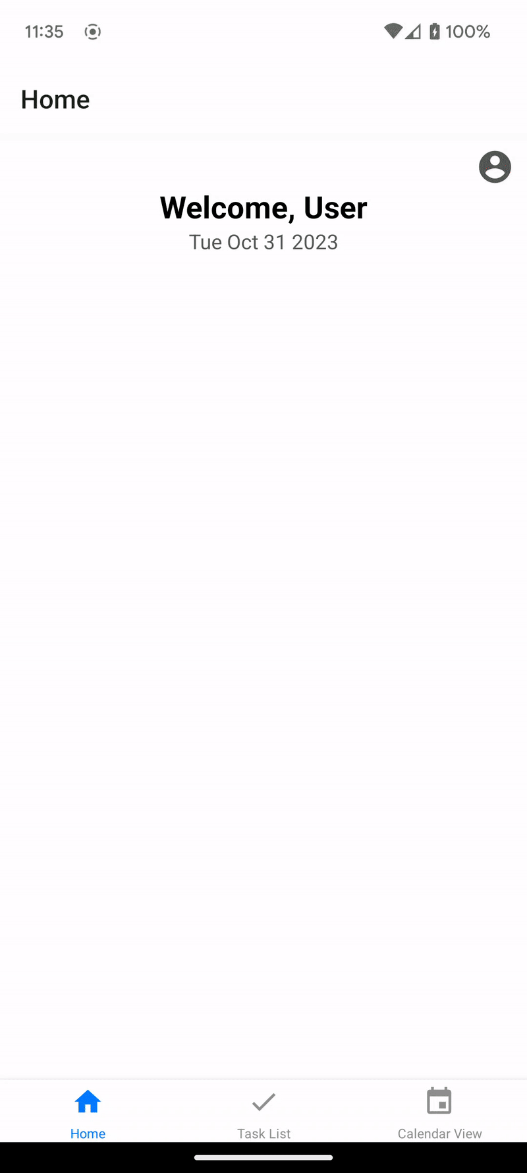
Task View
Sagar and Kyle worked on setting up the Task List page with adding and checking off functions.
Notes:
20 seconds

Slide 13
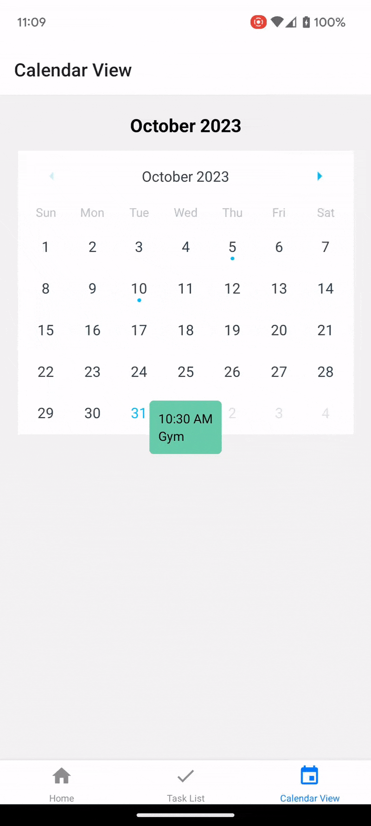
Calendar View
Sagar has made a very basic Calendar View page with an interactive calendar and a placeholder task block showing what task view blocks will look like.
Notes:
20 seconds

Slide 14
Progress Summary
The focus right now is to build out these sections: Overview, Task List, Calendar, Account, and Settings. Each group member will be working to integrate front end and back end elements. All code for the app shown above are on our GitHub in the branch named “Experimental-SagarsBranch”
Notes:
20 seconds

Slide 15
Thank you!

